Slide 1

CAR PRICE PREDICTION

Slide 2
INTRODUCTION
With the covid 19 impact in the market, we have seen lot of changes in the car market. Now some cars are in demand hence making them costly and some are not in demand hence cheaper. One of our clients works with small traders, who sell used cars. With the change in market due to covid 19 impact, our client is facing problems with their previous car price valuation machine learning models. So, they are looking for new machine learning models from new data. We have to make car price valuation model.

Slide 3
Hardware and Software Requirements and Tools Used
RAM: 8GB
ROM: I3 processor
SOFTWARE: Python 3.9.6
LIBRARIES: Numpy, Pandas, Seaborn, Sklearn, Scipy .
Tools: Jupiter notebook, Matplotlib, Scikit-learn, Excel.
Testing of Identified Approaches (Algorithms)
K-Neighbors Regressor
Decision Tree Regressor
Random Forest Regressor
Ridge
Lasso
Logistic Regressor

Slide 4
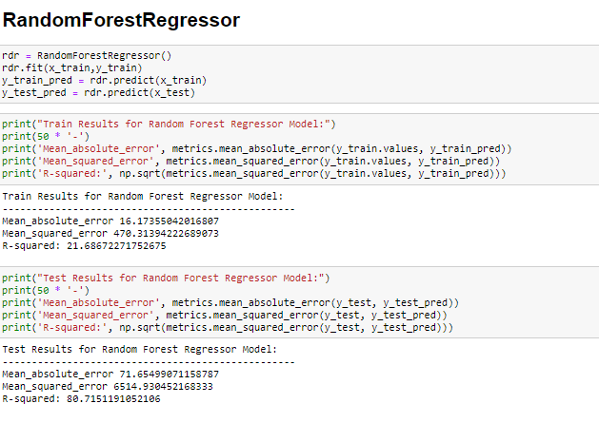
Run and Evaluate selected models
MODELS

Slide 5
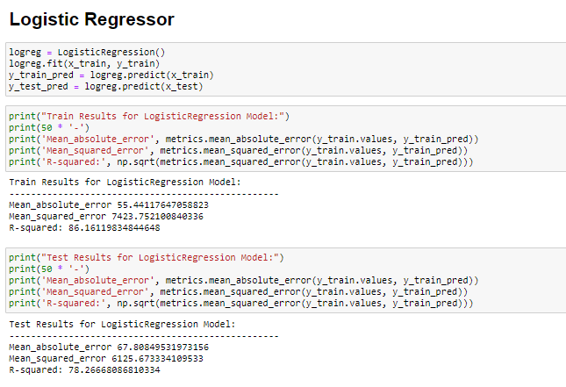

Slide 6
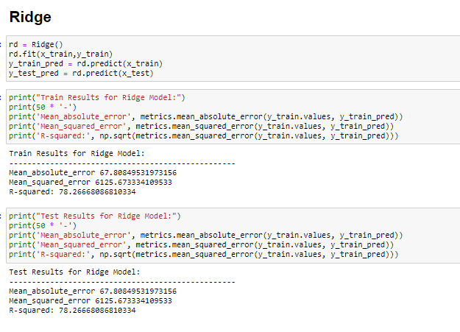

Slide 7
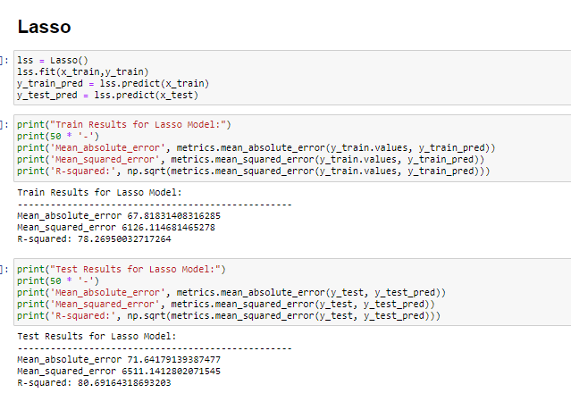

Slide 8
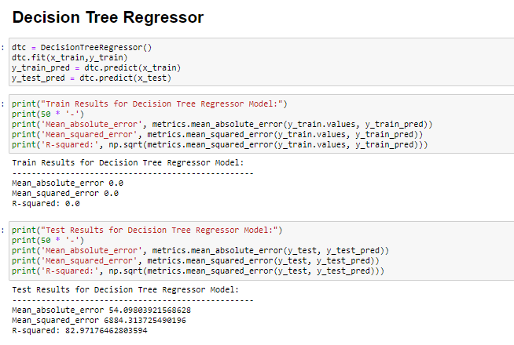

Slide 9
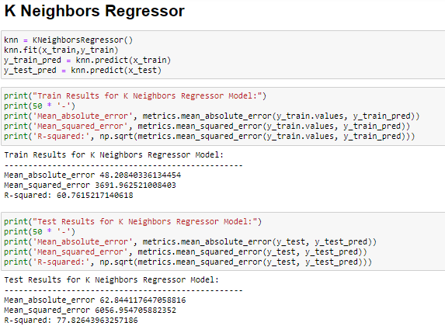

Slide 10
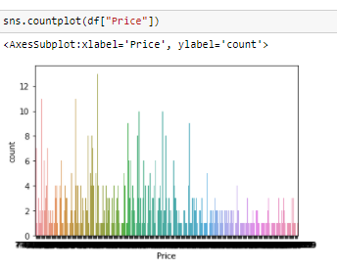
Visualizations
Count plot
Boxplot
Distplot
Scatterplot
Heatmap
Countplot

Slide 11
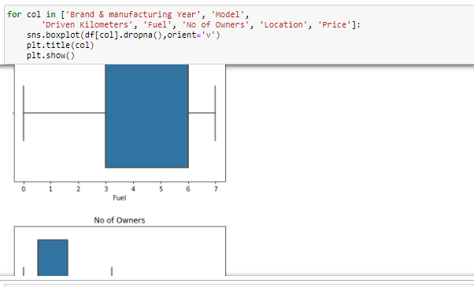
2) Boxplot

Slide 12
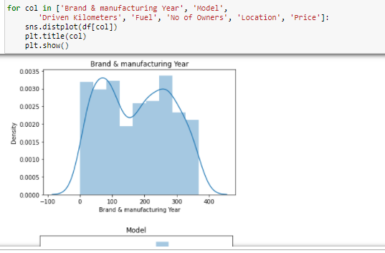
3) Distplot

Slide 13
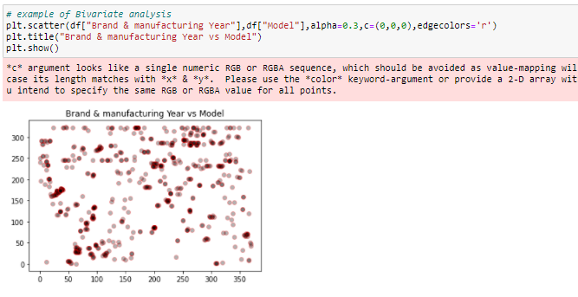
4) Scatterplot

Slide 14
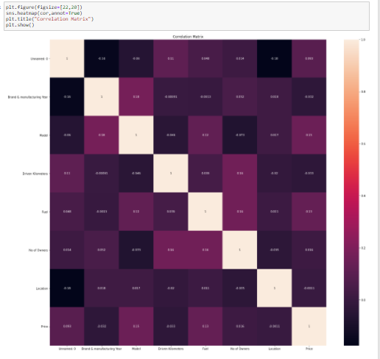
5) Heatmap

Slide 15
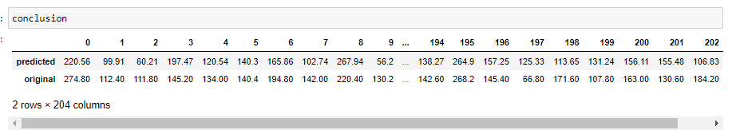
CONCLUSION
In these project, Decision Tree Regressor, Random Forest Regressor, K-Neighbors Regressor, Ridge, Lasso these models are used.
Decision Tree Regressor is r2 score ,Mean absolute error, Mean_squared_error and R-squared is good than other models, Hence Decision Tree Regressor is performing is good.
Decision Tree Regressor is best model for this dataset.

Slide 16
THANK YOU

